Slide 1


BEYOND THE SEAS:
HIGHER STUDY PLANNER
Presented By
1805092

Slide 2

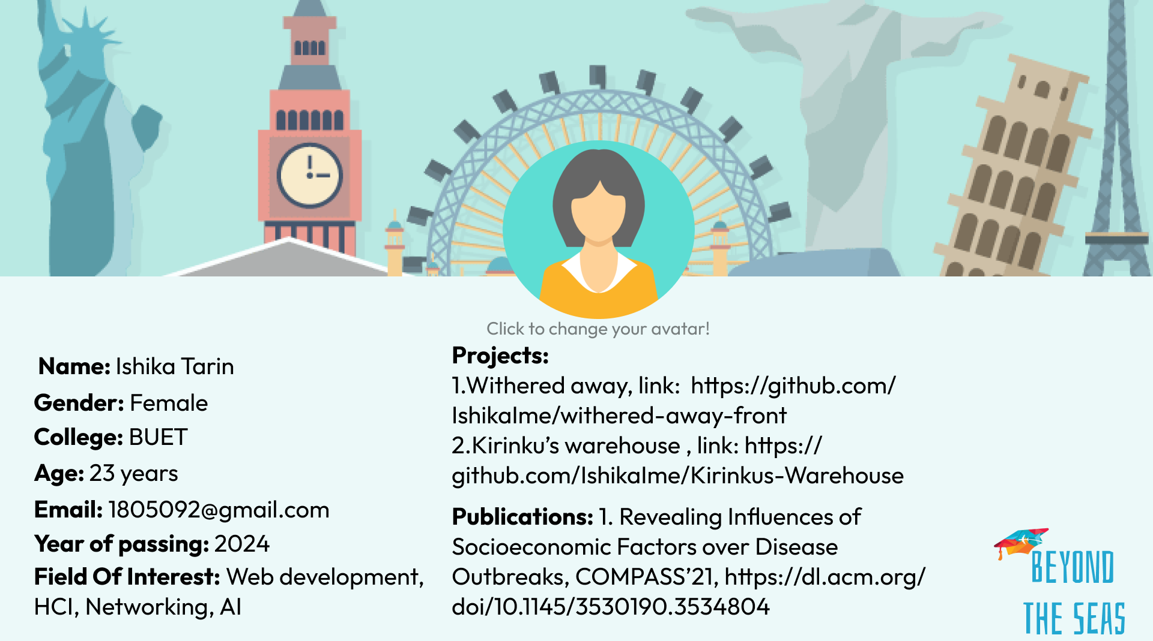
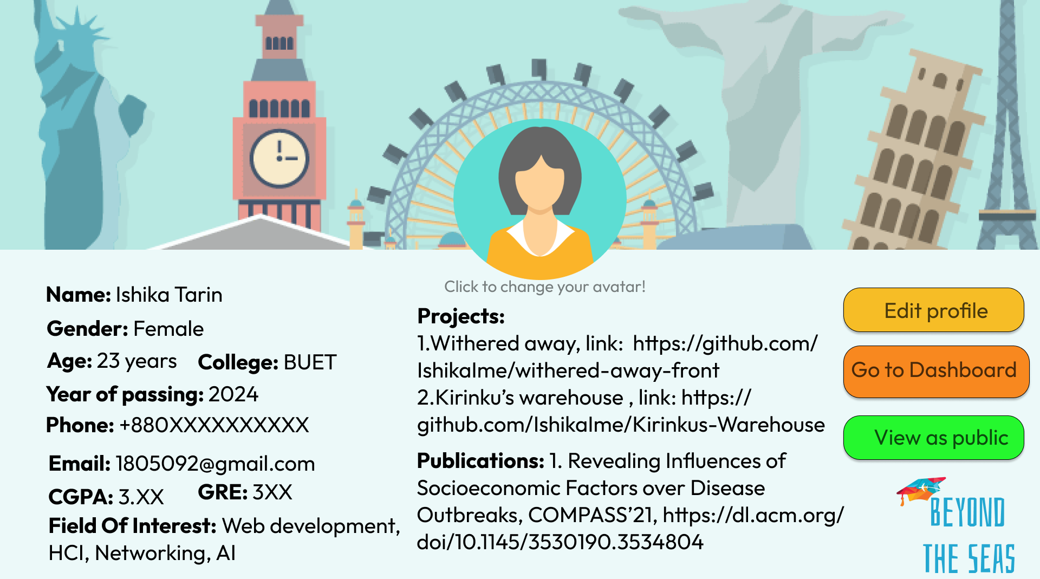
Profile as public
Profile as private

Slide 3
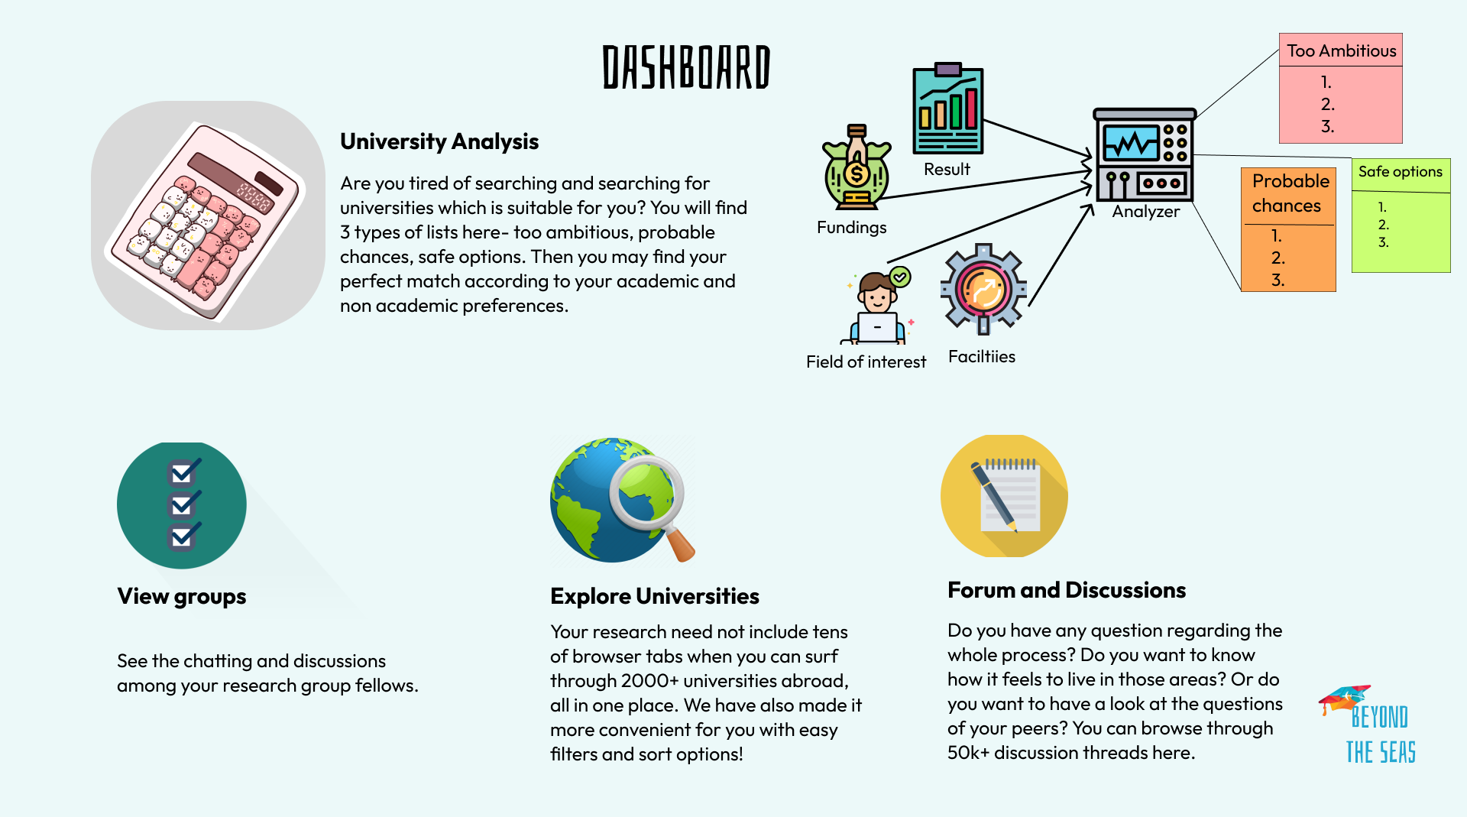

Slide 4
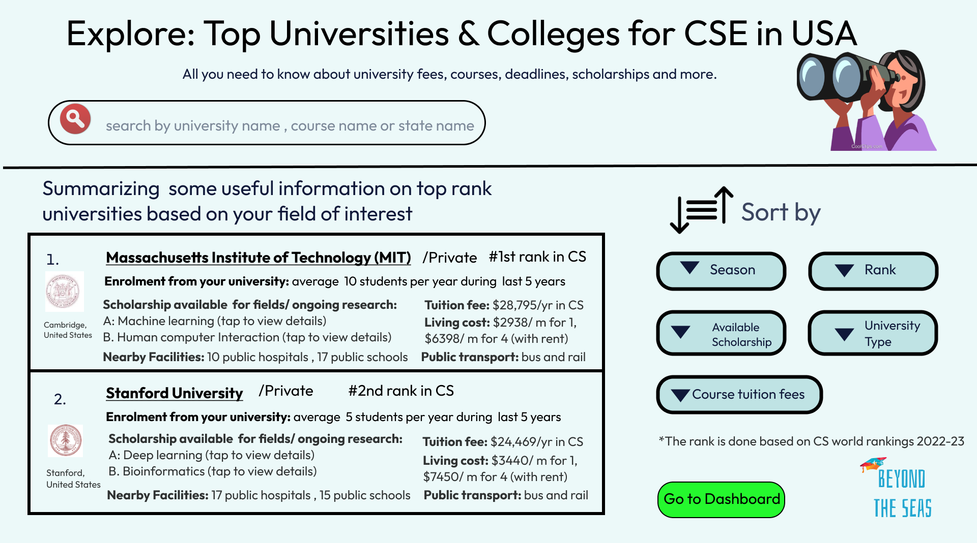

Slide 5
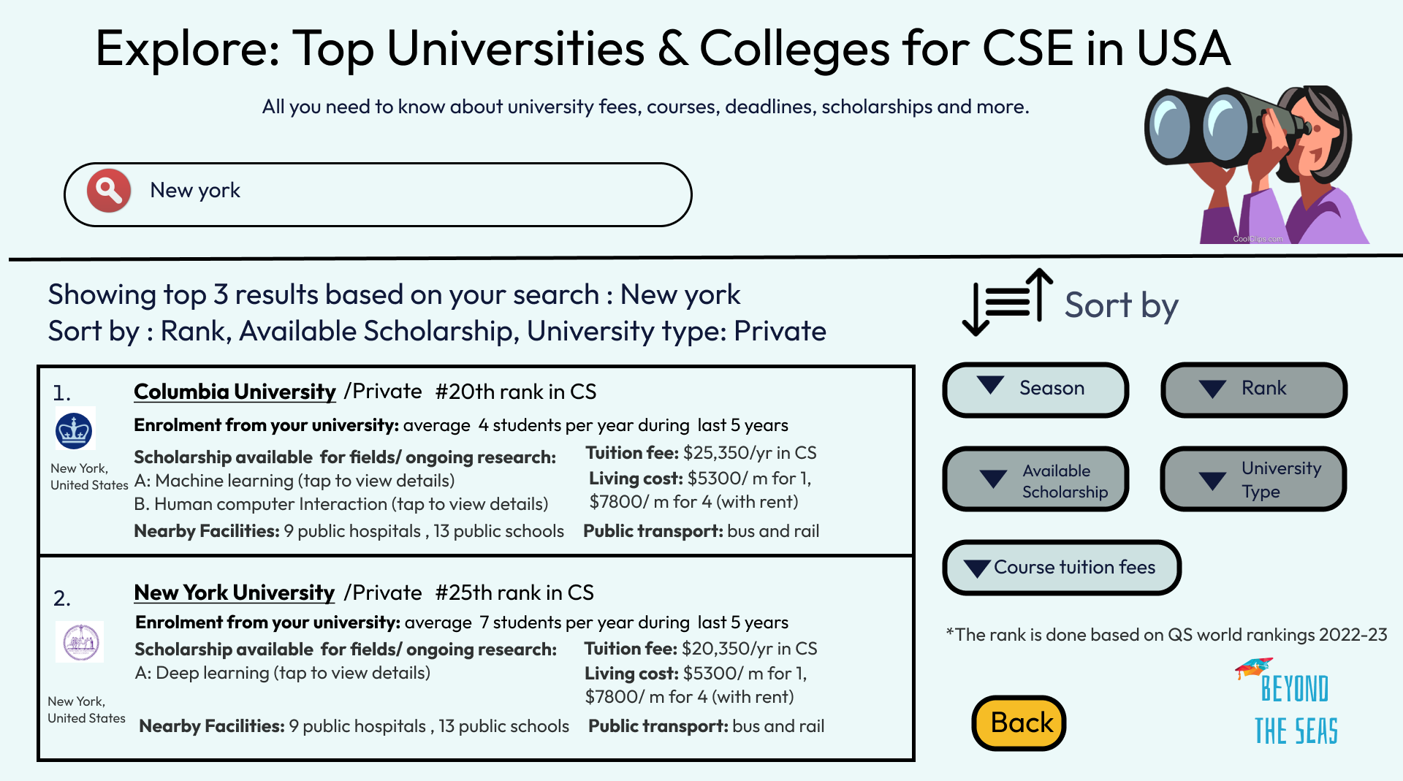

Slide 6
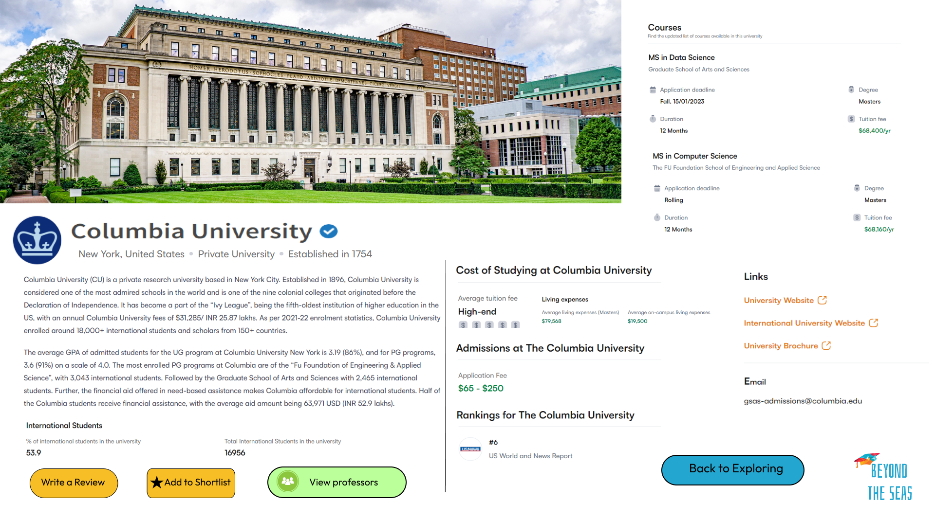

Slide 7
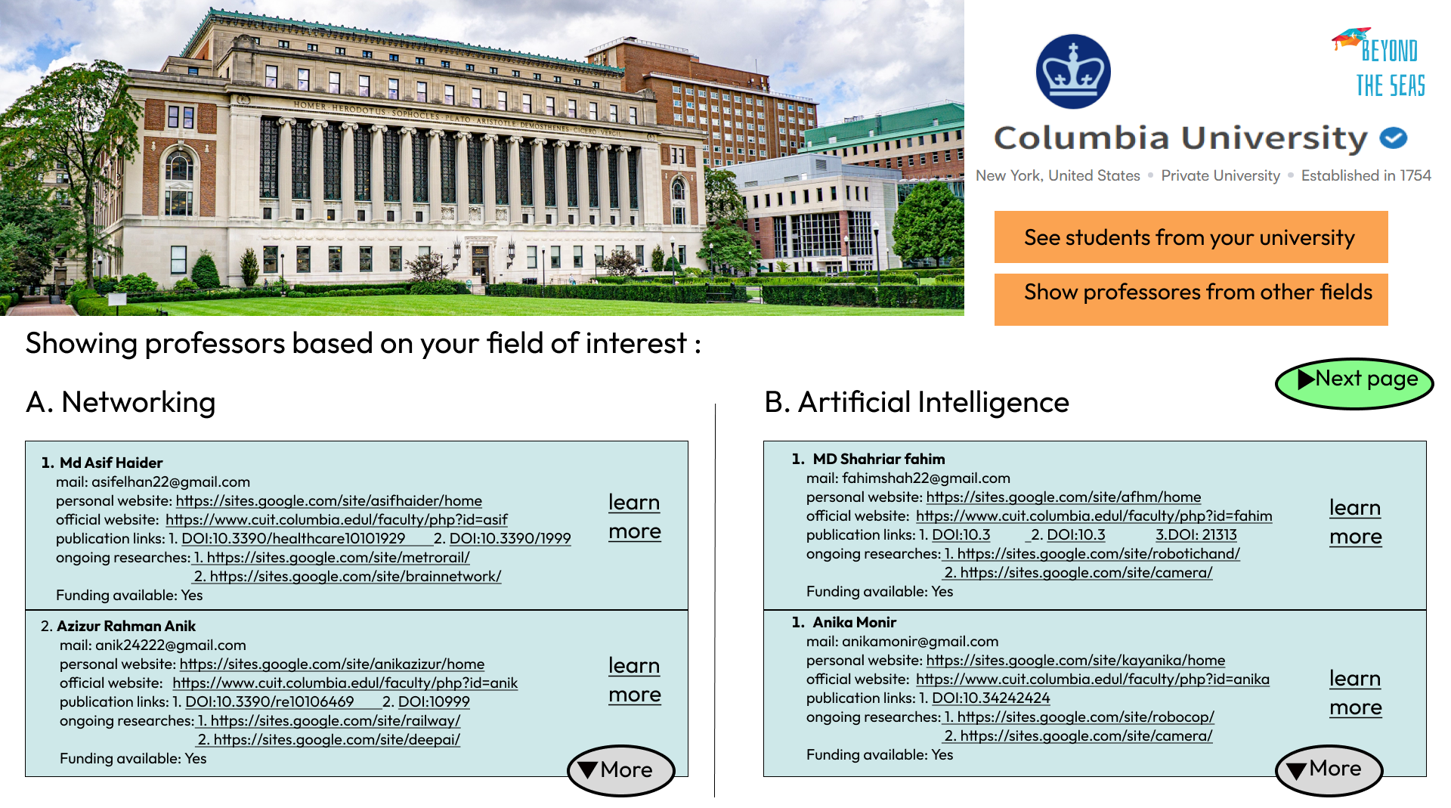

Slide 8
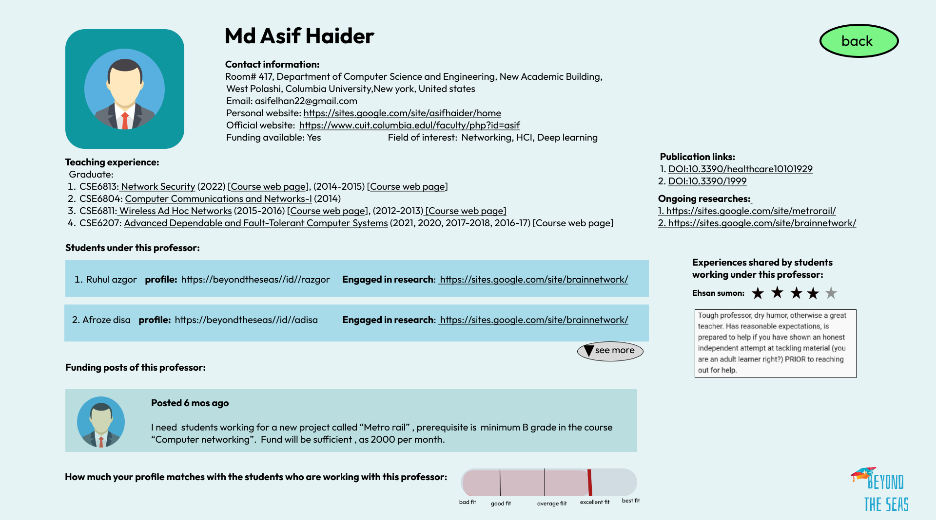

Slide 10
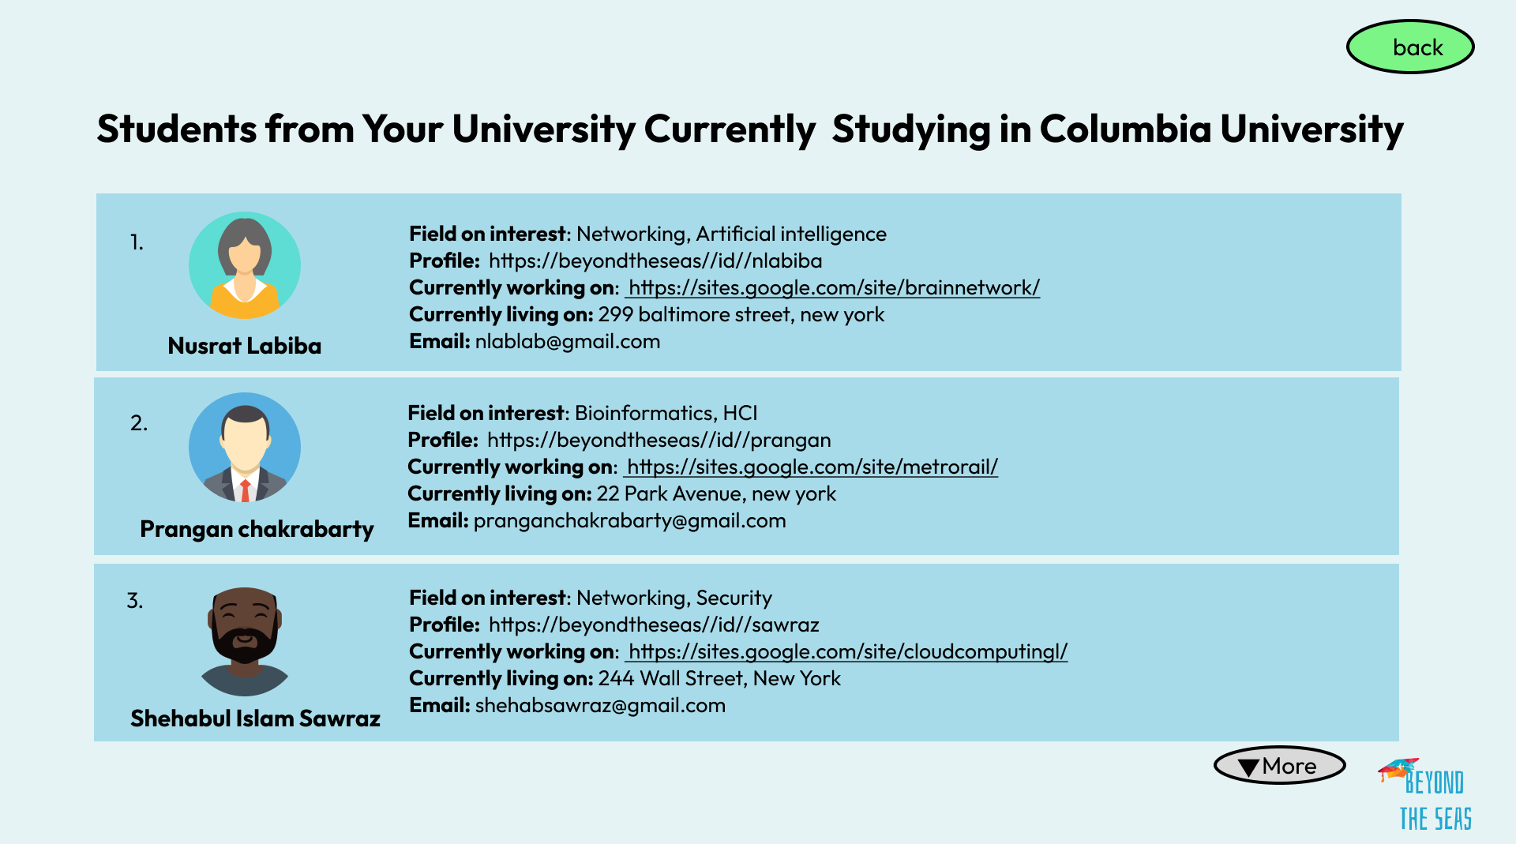

Slide 11

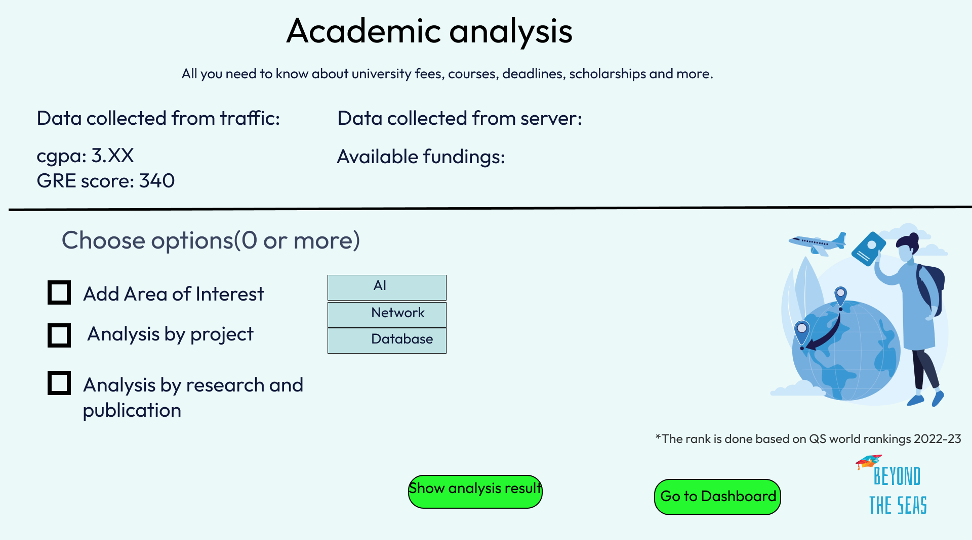
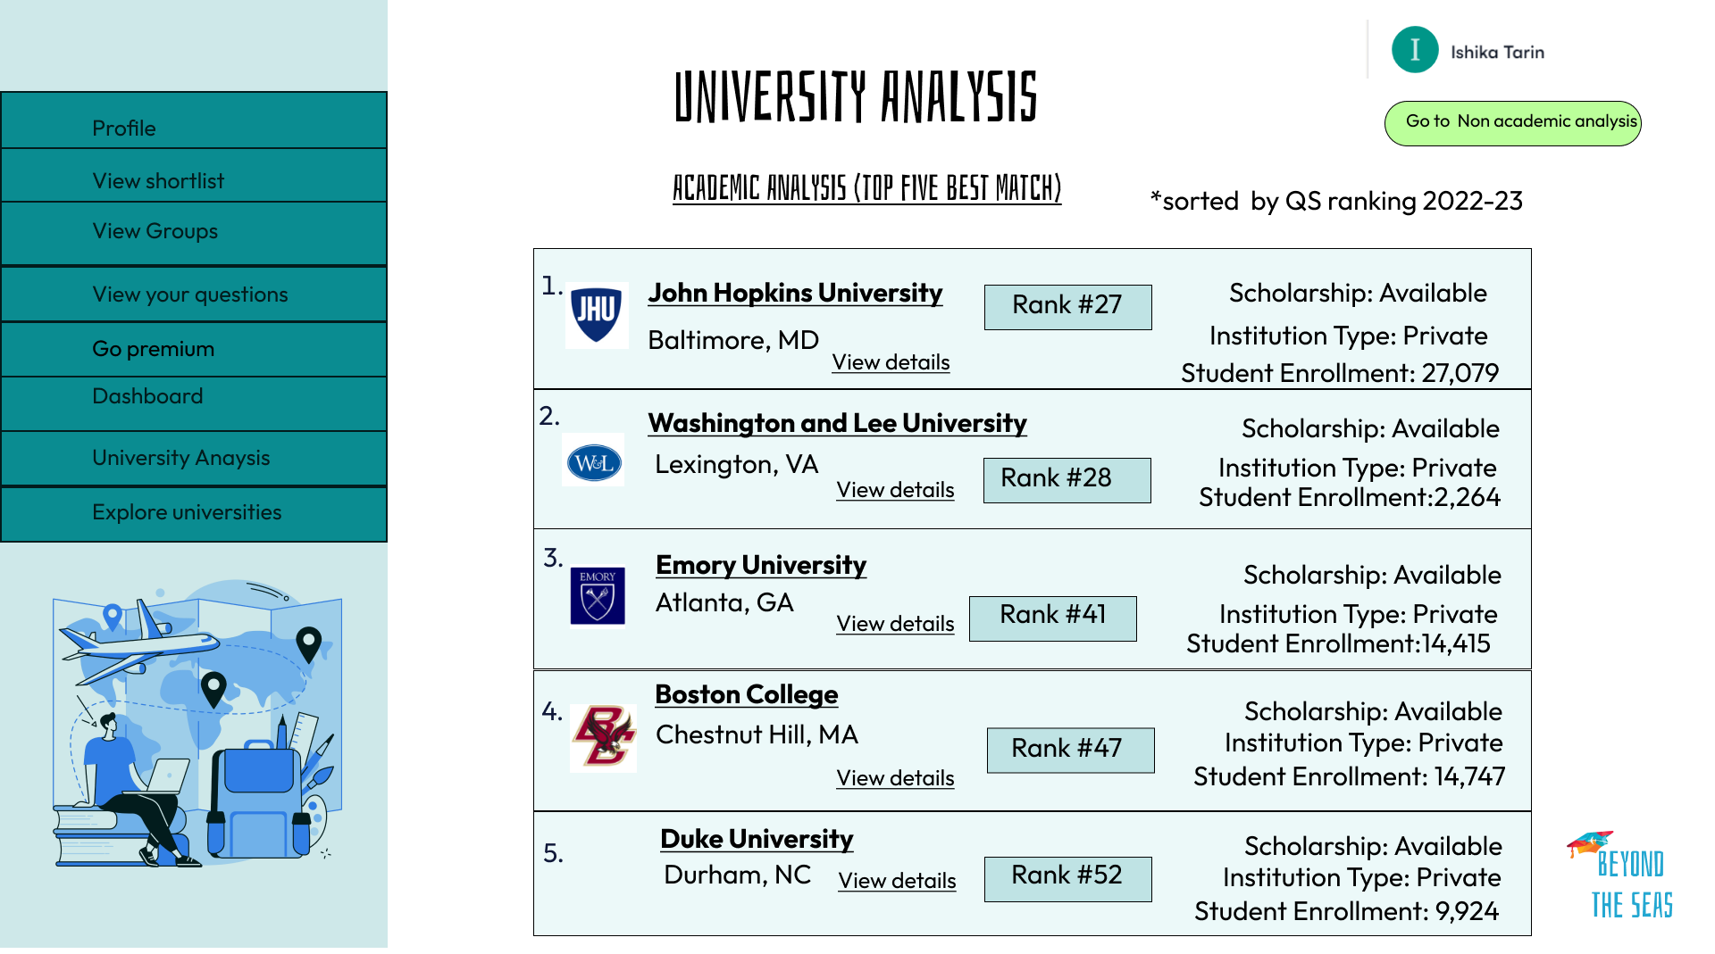
Academic Analysis (Based on CGPA, GRE, Area of interest/ project/ research or publication)

Slide 12
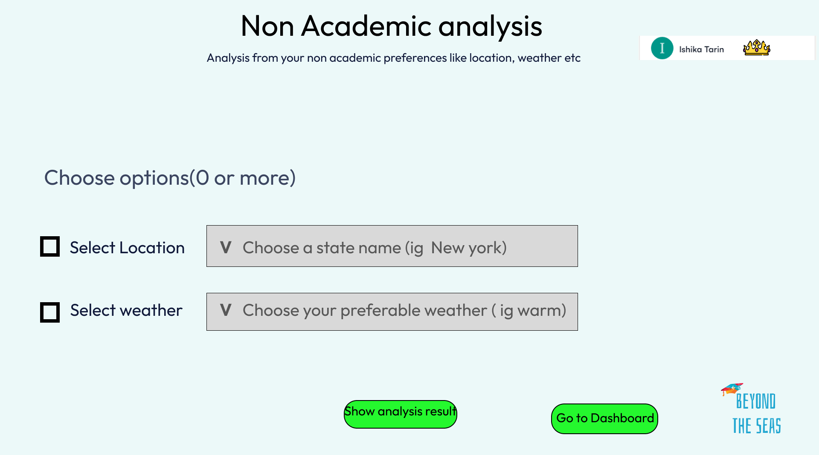
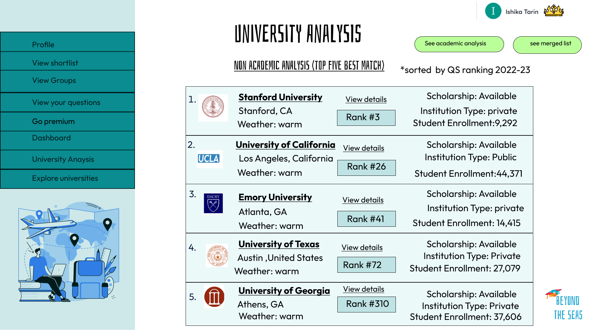
Non-Academic Analysis (Based on non-academic preference like location, weather )

Slide 13
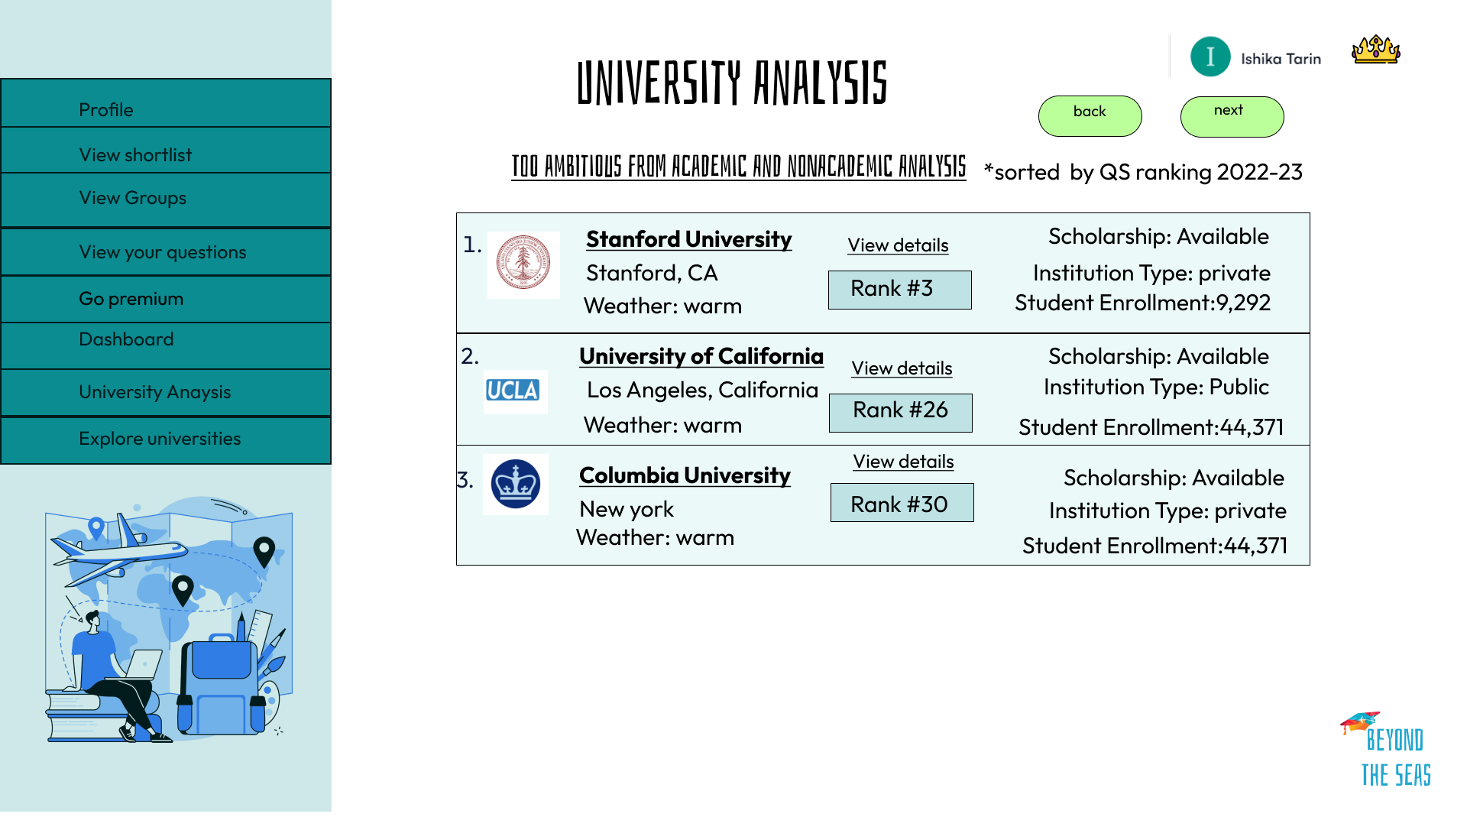
Merged Analysis: Too Ambitious

Slide 15
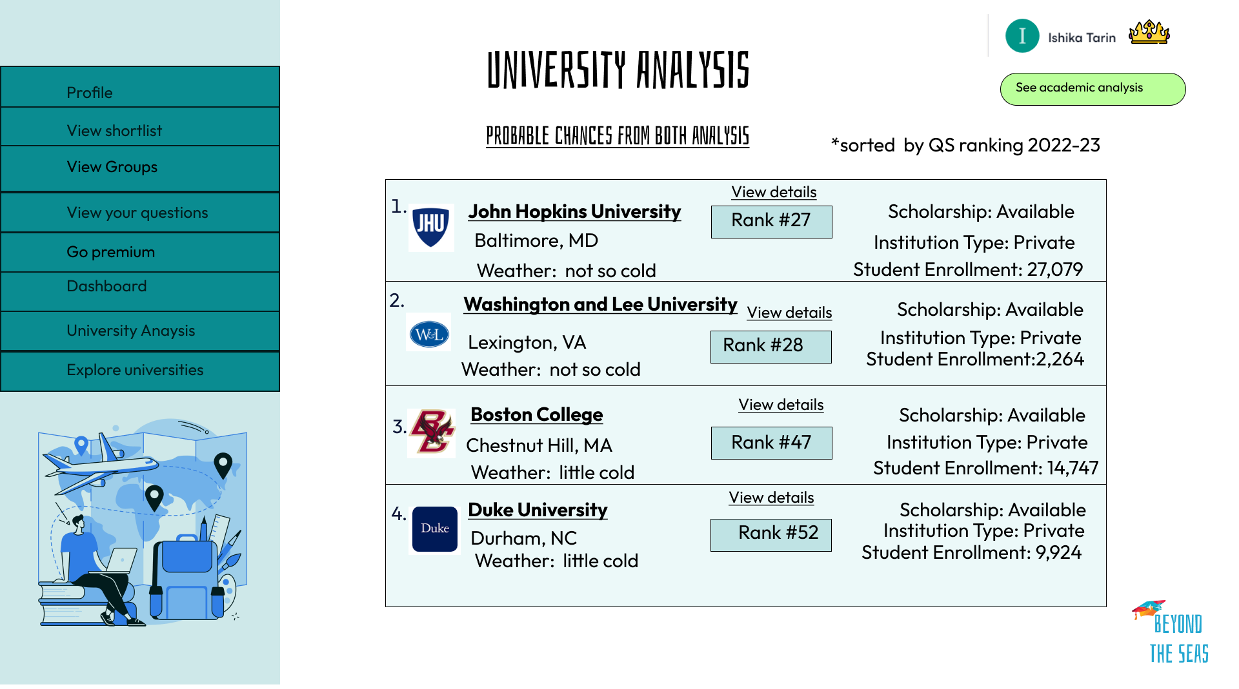
Merged Analysis: Probable chances

Slide 16
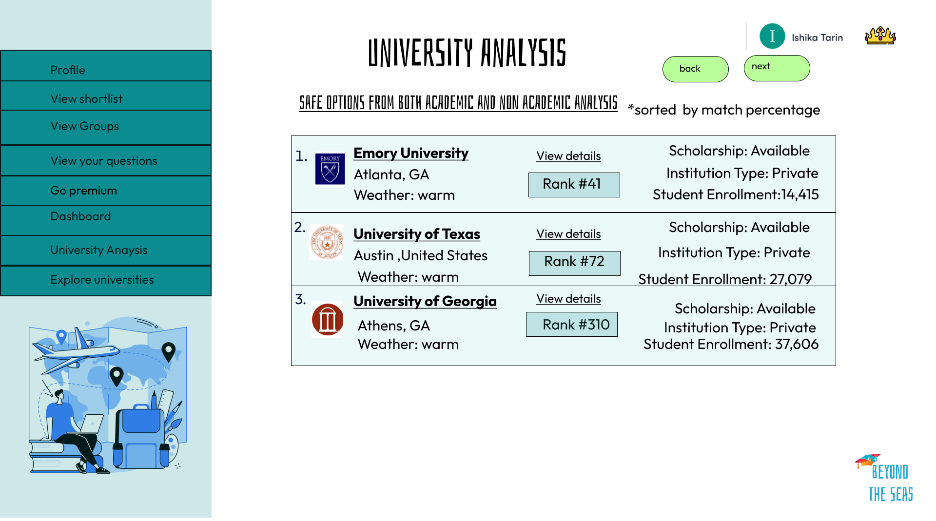
Merged Analysis: Safe options

Slide 17
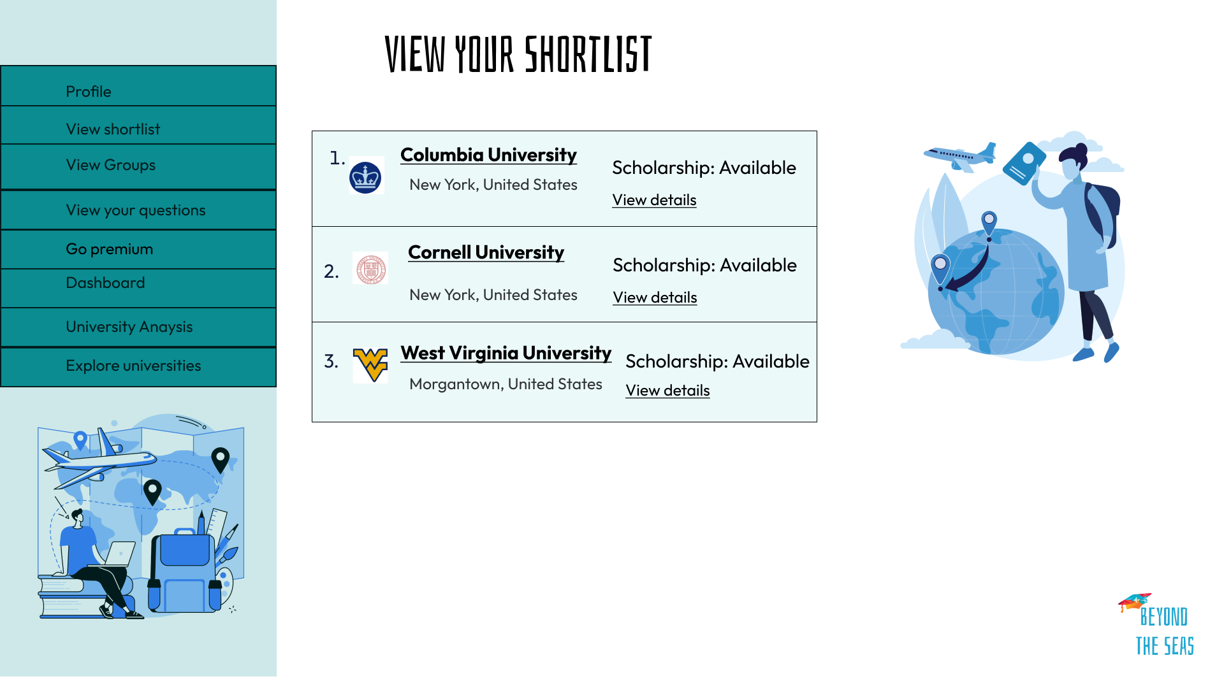

Slide 18
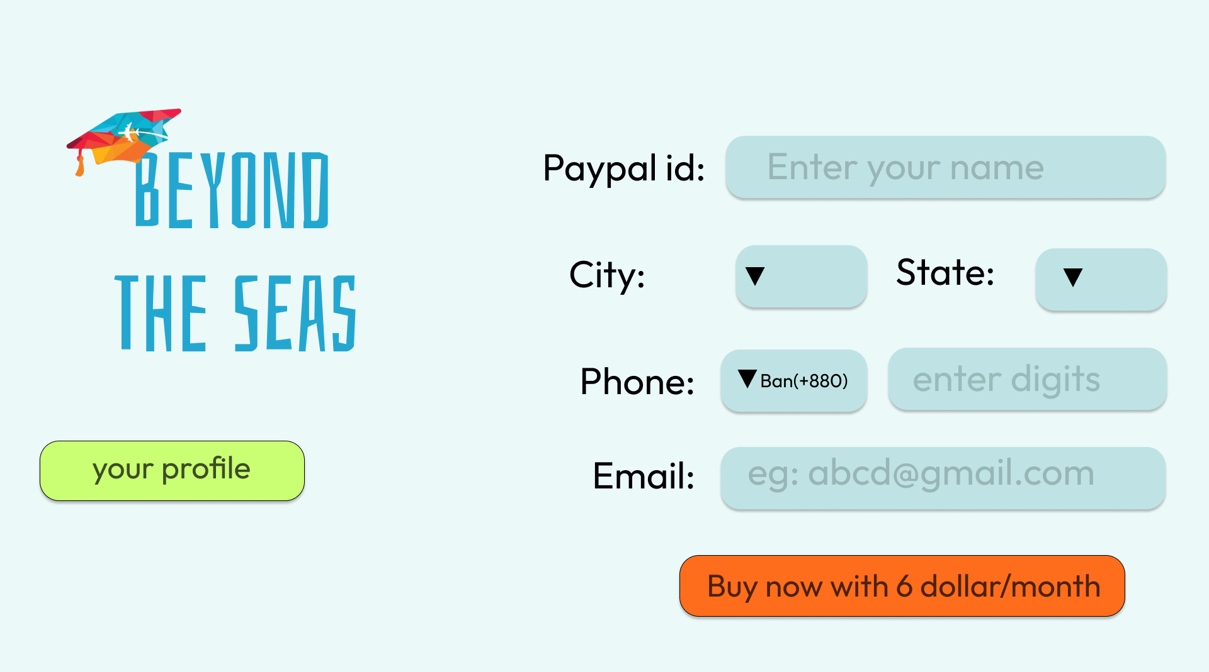
Register as a premium user

Slide 19

see
We have nothing to lose and a world to
Prepared By
1805092,1805110,1805112
1805113,1805115,1805116

